Slide 1

Citizen Registration and Appointment for
Vaccination
User Manual

Slide 2

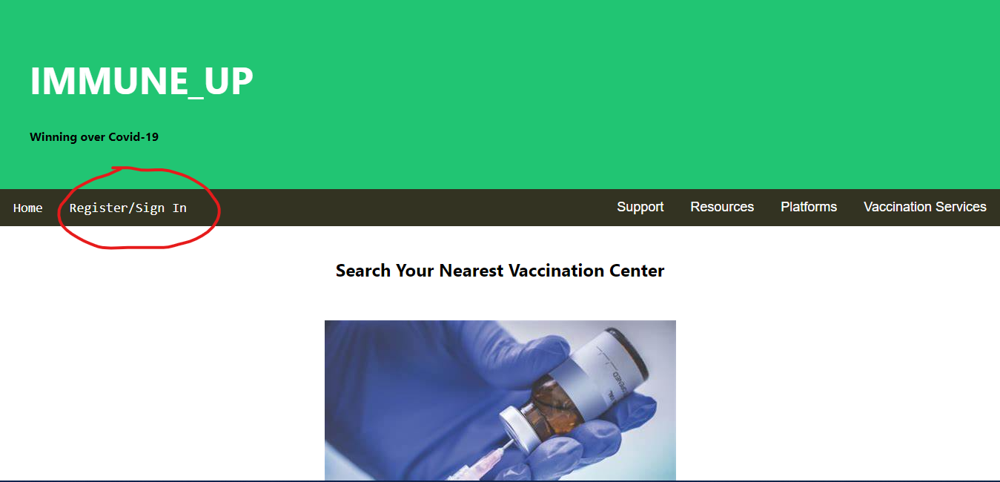
User Manual
Citizen Registration and Appointment for Vaccination

Slide 3
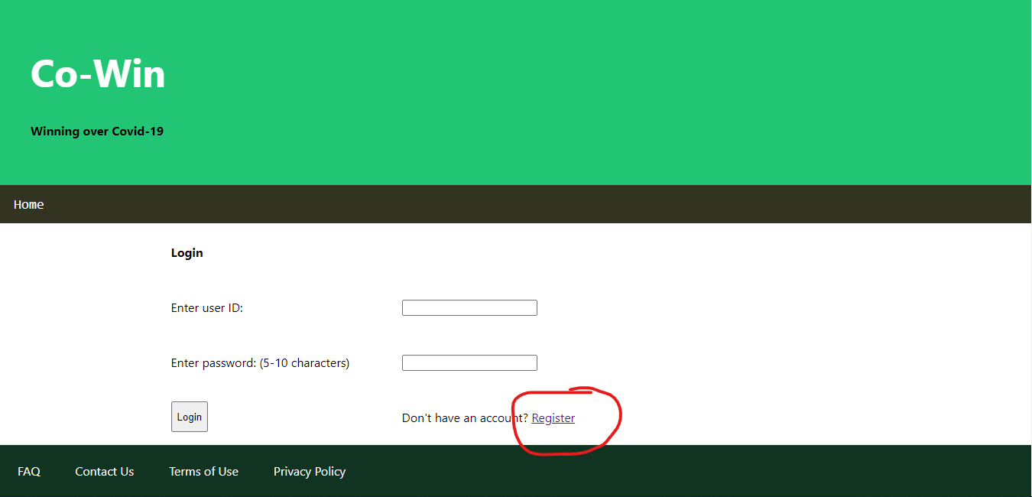
User Manual
Citizen Registration and Appointment for Vaccination

Slide 4
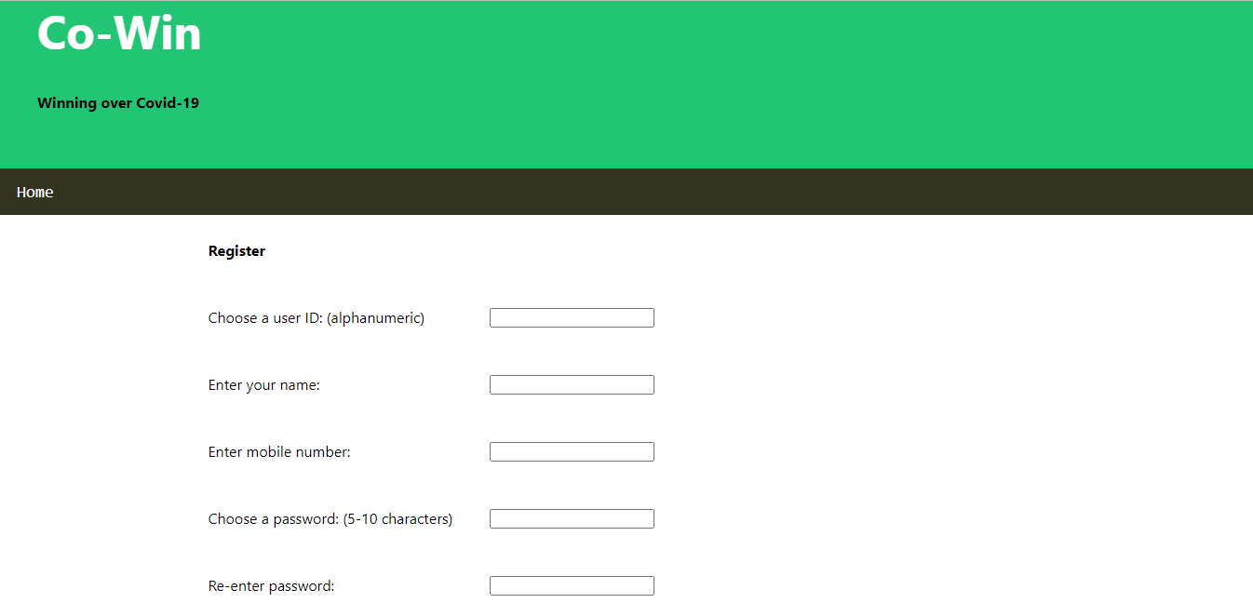
User Manual
Citizen Registration and Appointment for Vaccination

Slide 5
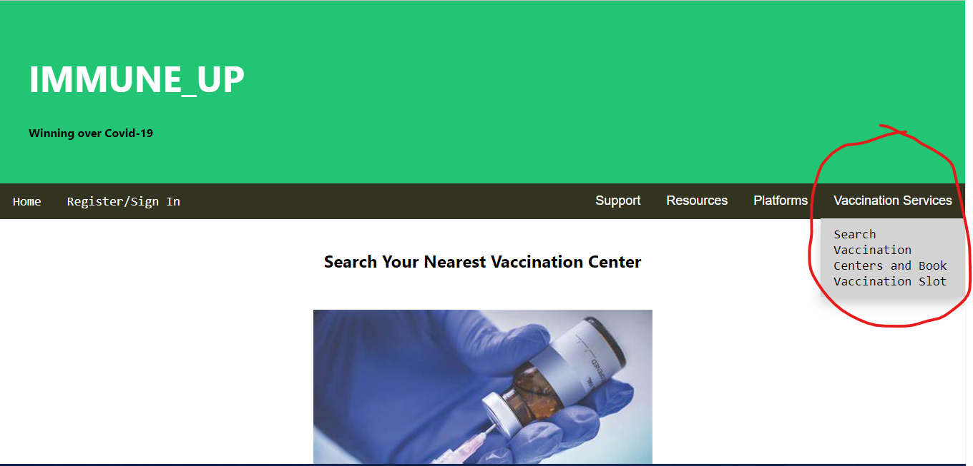
User Manual
Citizen Registration and Appointment for Vaccination

Slide 6
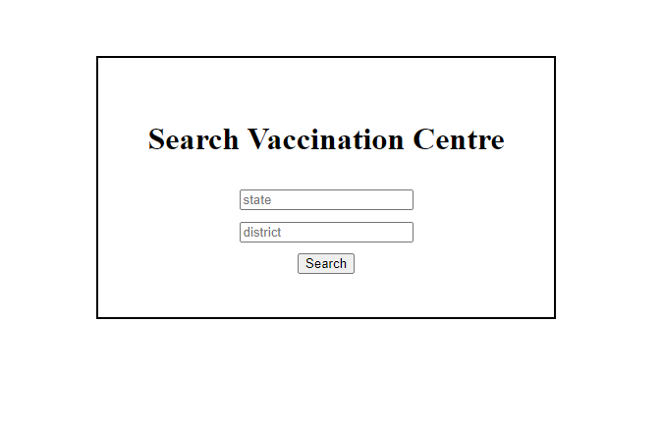
User Manual
Citizen Registration and Appointment for Vaccination

